Slide 1
BattleShip Network
Multiplayer Battleship using OCSF & JDBC
Project by Gwen Massingill, Seth Orvin, Kat Kaelin, Shelly Wieburg, & Jocelyn Sims

Slide 2
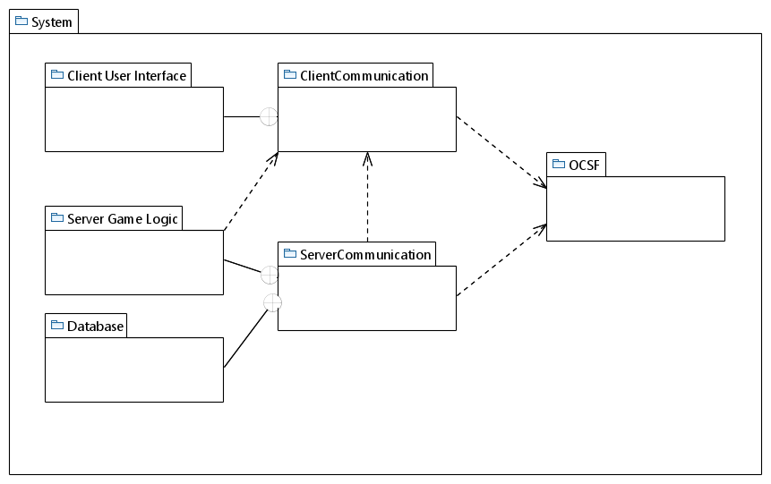
Package Diagram
Gwen & Seth
Kat & Gwen
Seth & Shelly
Jocelyn
Seth & Jocelyn

Slide 3
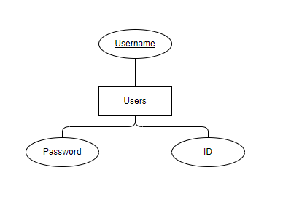
Database Design Diagram

Slide 4
Functional Requirement Example
(PlaceShip)
Each Player will have five ships in their fleet. Two of the ships will be of length 2 and the three remaining ships will be of lengths 3, 4, and 5. When the game starts, a Player’s fleet will appear outside of the grids, and they will use their mouse to select and place each of their ships onto their ocean grid

Slide 5
Use Case Description Example
Use Case: PlaceShip
Actors: Player
Player selects a ship from their fleet.
Player clicks the cell on their ocean grid to which they want to place the selected ship.
System checks if the selected ship can occupy the selected cell and extend into empty neighboring cells without colliding with the ocean grid’s border or with another placed ship.
System places the ship at the cell
Entry Condition:
Two Players have started a game but have not yet locked their ships in place on their ocean grids.

Slide 6
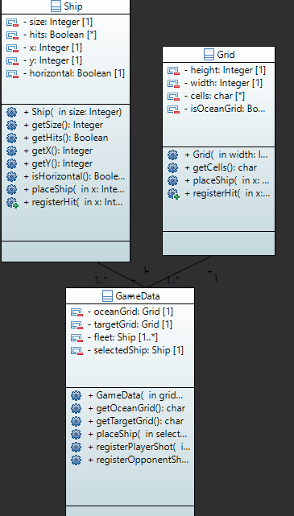
Initial Class Diagram Example

Slide 7
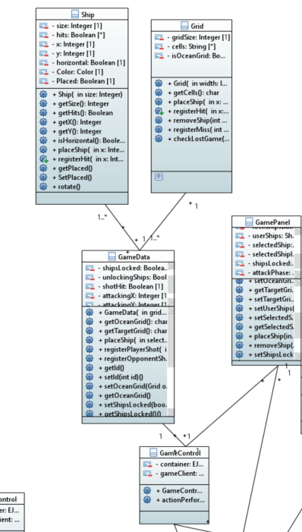
Final Class Diagram

